Slide 1
CoFiNet: Reliable Coarse-to-Fine Correspondences for Robust Point Cloud Registration Hao Yu, Fu Li, Mahdi Saleh, Benjamin Busam, and Slobodan Ilic. Neural Information Processing Systems 34 (NeurIPS 2021)
Presented by Karthik Venkatasivareddy

Slide 2
Motivation
Many 3D learning methods are “two-stage”: sparse keypoints/descriptors → RANSAC.
Keypoint sparsity hurts repeatability: subsampling can drop the corresponding point in the other frame → worse matching.
CoFiNet employs coarse-to-fine correspondences to mitigate pitfalls in keypoint detection.

Slide 3
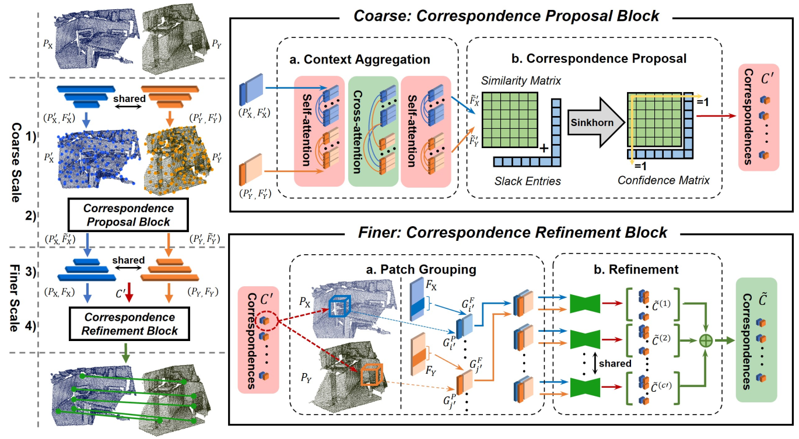
﻿Overview of pipeline

Slide 4
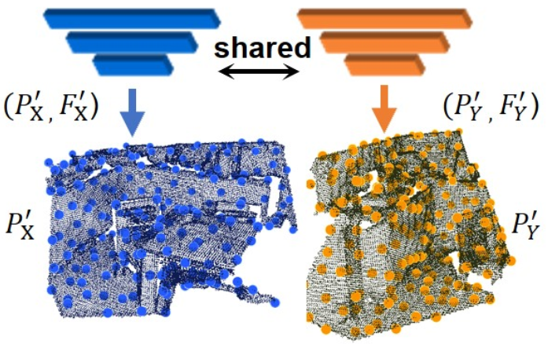
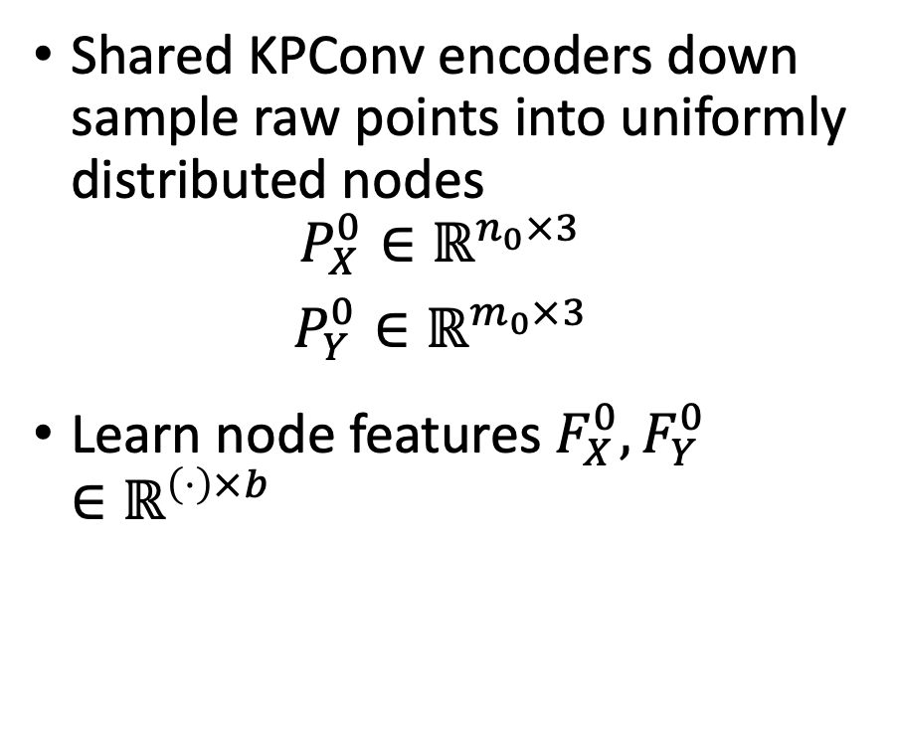
Coarse stage: node encoding
Shared KPConv encoders down sample raw points into uniformly distributed nodes
$$P_{X}^{0}∈ℝ^{n_{0}×3}$$
$$P_{Y}^{0}∈ℝ^{m_{0}×3}$$
Learn node features $F_{X}^{0},F_{Y}^{0}∈ℝ^{\left(⋅\right)×b}$

Slide 5
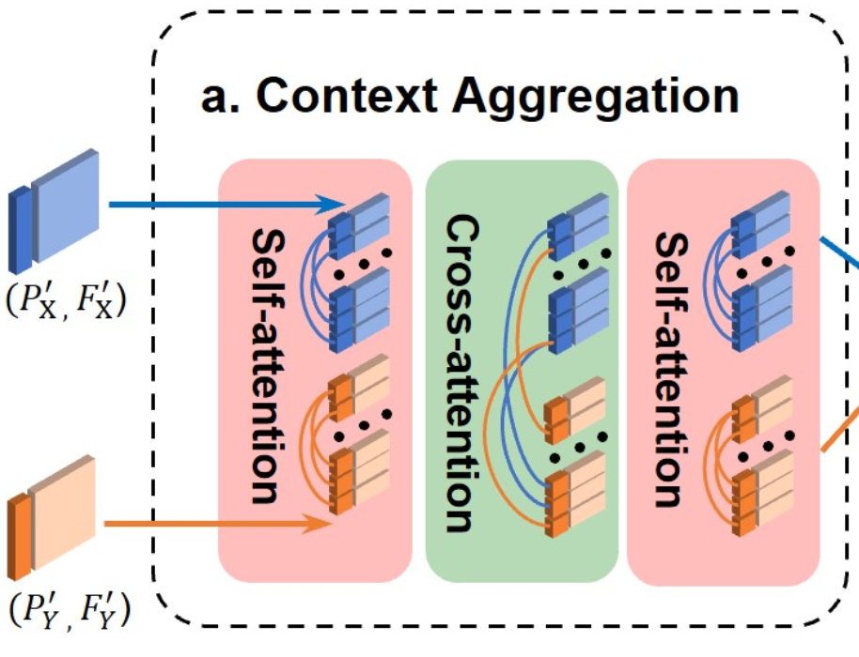
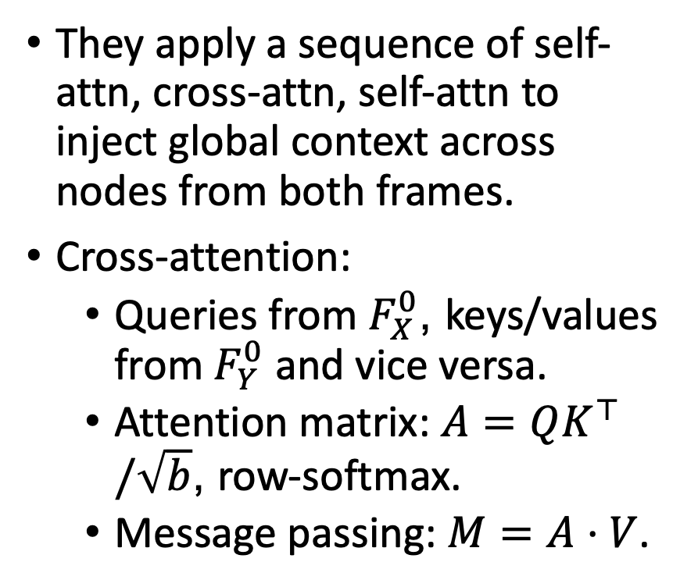
CPB: attention-based context aggregation
They apply a sequence of self-attn, cross-attn, self-attn to inject global context across nodes from both frames.
Cross-attention:
Queries from $F_{X}^{0}$, keys/values from $F_{Y}^{0}$ and vice versa.
Attention matrix: $A=QK^{⊤}/\sqrt{b}$, row-softmax.
Message passing: $M=A⋅V$.

Slide 6
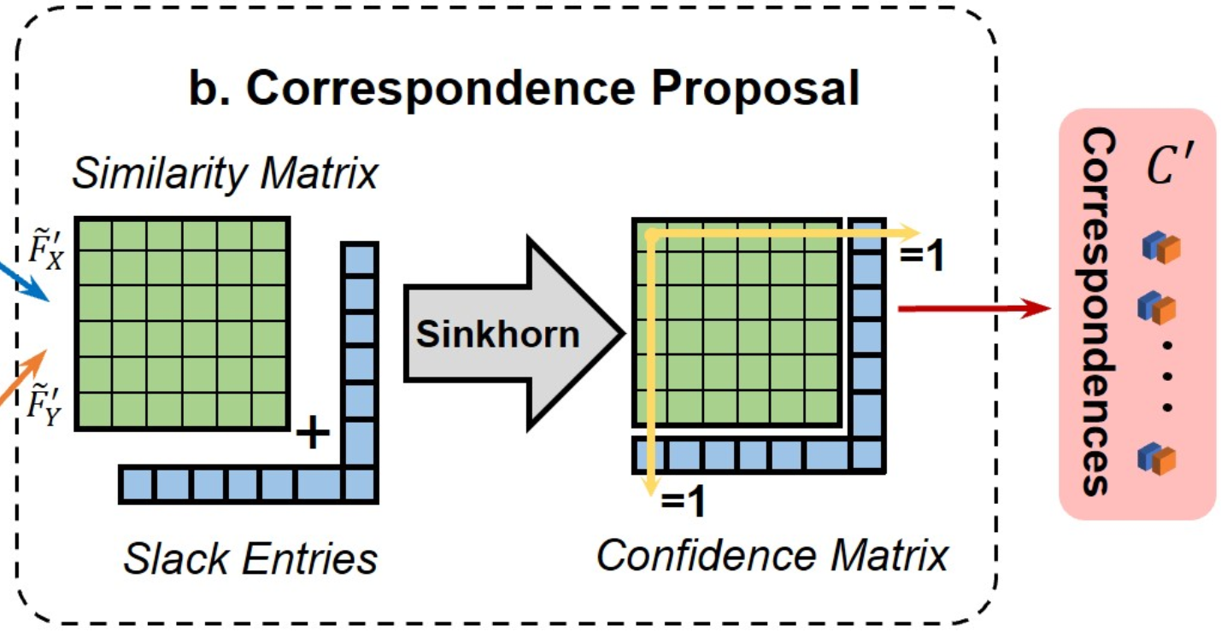
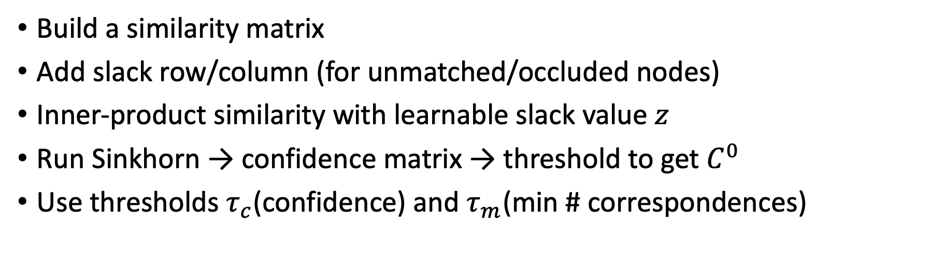
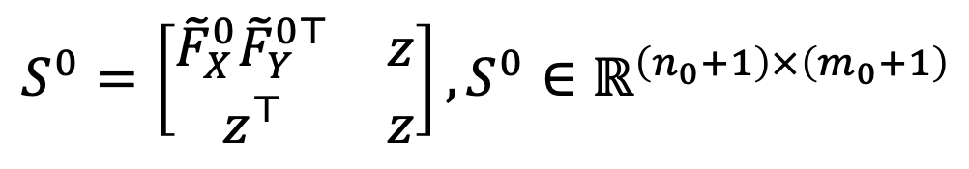
Coarse-scale Matching: Correspondence proposal
$$S^{0}=\left[\begin{matrix}{\tilde{F}}_{X}^{0}{\tilde{F}}_{Y}^{0⊤} & z \\ z^{⊤} & z\end{matrix}\right], S^{0}∈ℝ^{\left(n_{0}+1\right)×\left(m_{0}+1\right)}$$
Build a similarity matrix
Add slack row/column (for unmatched/occluded nodes)
Inner-product similarity with learnable slack value $z$
Run Sinkhorn → confidence matrix → threshold to get $C^{0}$
Use thresholds $τ_{c}$(confidence) and $τ_{m}$(min # correspondences)

Slide 7
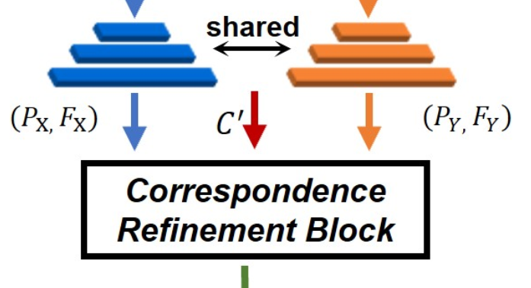
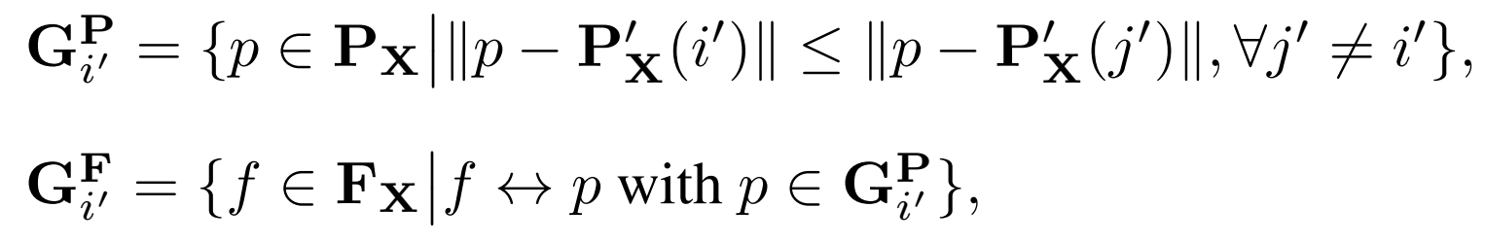
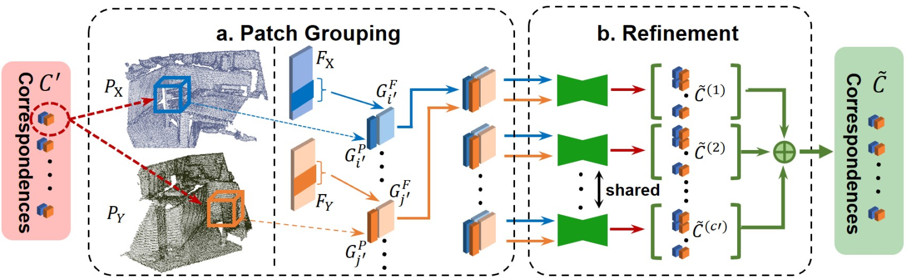
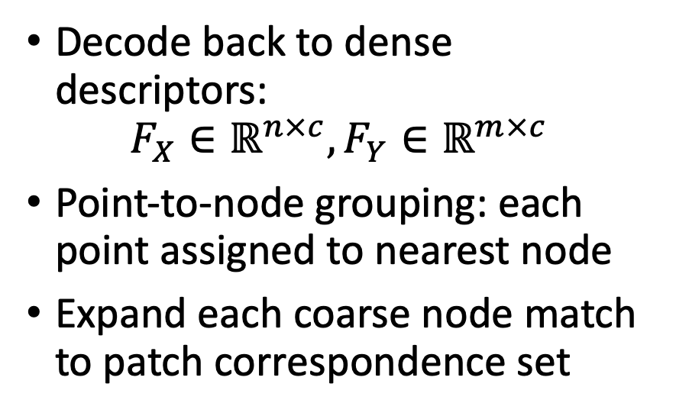
Point-level Refinement: Node decoding + patch construction
Decode back to dense descriptors:
$$F_{X}∈ℝ^{n×c},F_{Y}∈ℝ^{m×c}$$
Point-to-node grouping: each point assigned to nearest node
Expand each coarse node match to patch correspondence set

Slide 8
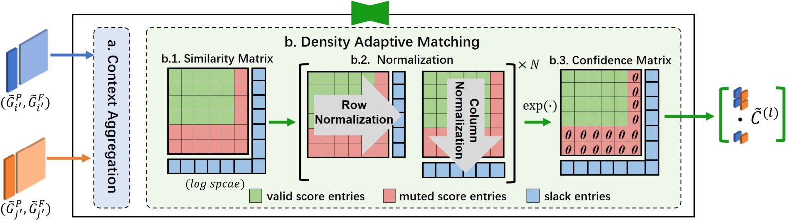

Point-level Refinement: Density-adaptive matching
Refinement = solve differentiable OT on truncated patches (size $k$)
Problem: truncation may repeat points → bias toward slack matches
Fix: mute repeated entries, control normalization, then pick max per row/column for precision

Slide 9

Loss Function
Total loss: $L=L_{c}+λL_{f}$
Coarse supervision: weighting scheme proportional to overlap ratios
Fine supervision: binary matrix + slack handling + ignore repeated points

Slide 10
Datasets and Metrics
Dataset:
Indoor - 3DMatch (>30% overlap), 3DLoMatch (10–30% overlap)
Outdoor: odometryKITTI
Metrics:
Registration Recall (RR)
Feature Matching Recall (FMR)
Inlier Ratio (IR)

Slide 11
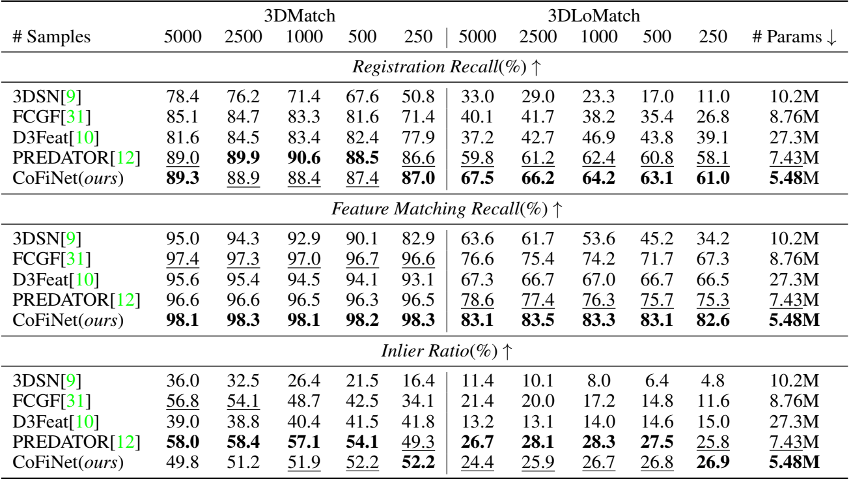
Results for ﻿3DMatch and 3DLoMatch

Slide 12
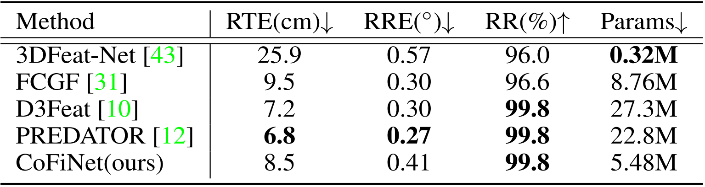
Results for KITTI

Slide 13
Additional slides

Slide 14
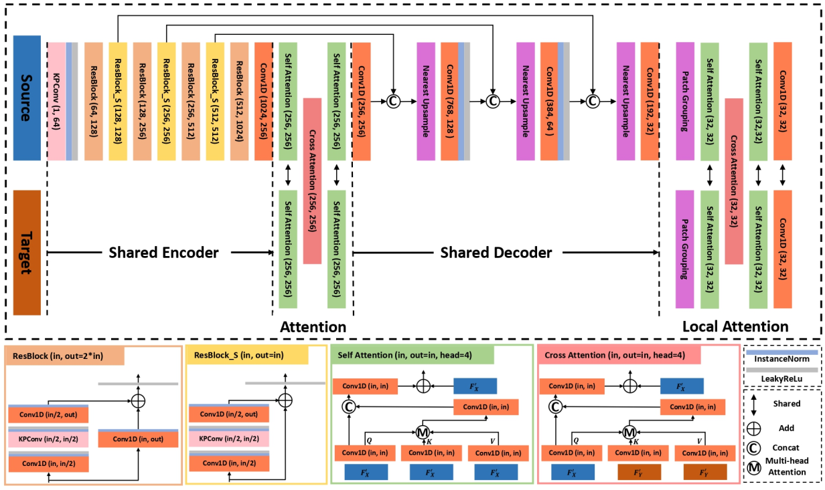
Detailed architecture

